Slide 1
Virtual Shelf
Browse, explore, find, read and bookmark books.
Raphaël Tuor
Christoph Reinhart
Nicolas Spycher

Slide 2
Contents
Application
Interfaces
CASE
CARE
Demo
Evaluation
Conclusion

Slide 3
1. Application
Virtual Library:
- Functions:
- Search for books
- Open and read books
- Navigate trough a book
- Mark and search text
- Set bookmarks
2 Modalities: Speech & Gestures vs. Keyboard & Mouse

Slide 4
Application
Technical Specifications:
IDE: Visual Studio
Programming Language: C#
Voice and Gesture recognition: Kinect

Slide 5
Fusion
WPF
(Fusion)
Kinect_Controller
(Captures Input)

Slide 6
2. Interfaces - 1st Interface
Technical details:
Kinect for Gesture- and Speech recognition
Fusion:
- Store the position of the right hand (cursor position) as a global value whenever a new frame is produced by the camera, send it to the Form
- If a speech command occurs, call the specific method in the Form and look up the position of the cursor

Slide 7
3. CASE model
Combined, Parallel = Synergistic
Point at a book and say bookmark
Point at a book and say open
Combined, Sequential = Alternate
Remove a bookmark
Parallel, Independent = Concurrent
Swipe trough a book and at the same time start a new search

Slide 8
4. CARE model
Complementary
You can only bookmark by using a combination of speech and gesture
You can only open a book by using a combination of speech and gesture
Equivalent
You can go to the next page by either swiping right with your left hand or by saying next.
Assignment
The user can only search for books by using voice commands

Slide 9
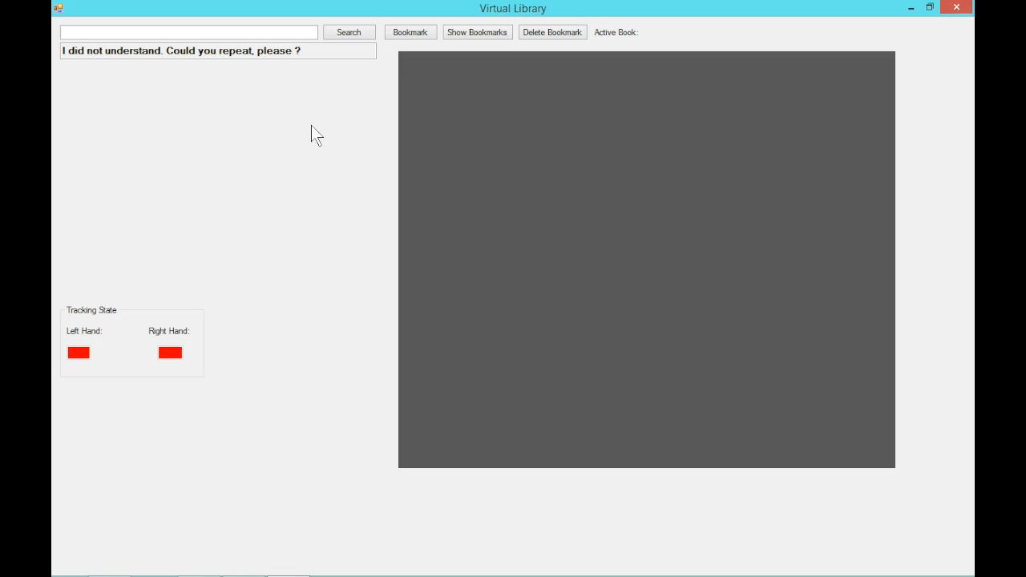
Demo
https://www.youtube.com/watch?v=Dq2qgaNge4k

Slide 10
6. Evaluation - Hypothesis
Can progressive interfaces enhance the experience and the productivity of an user compared to an interface he is already accustomed to?

Slide 11
6. Evaluation
Task given to users, with both modalities:
Open the book called “A History of Mathematics”
In the book, search for the word “Gutenberg”
Go to page 10
Bookmark this book
Bookmark another book called “First Six Books of the Elements of Euclid”
Show all the bookmarks

Slide 12
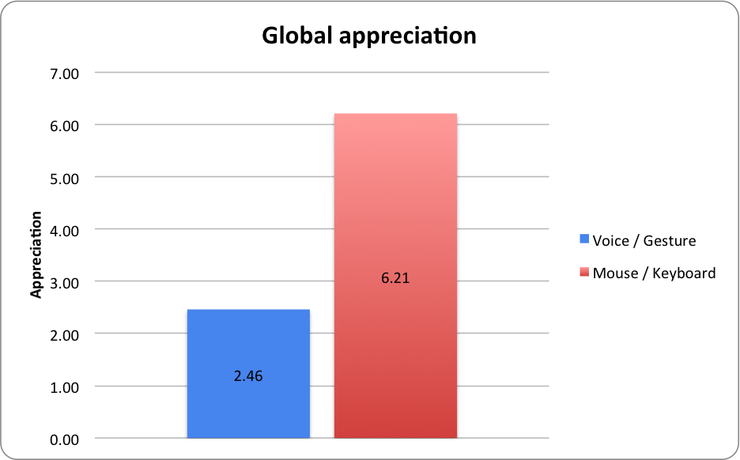
Evaluation results - qualitative

Slide 13
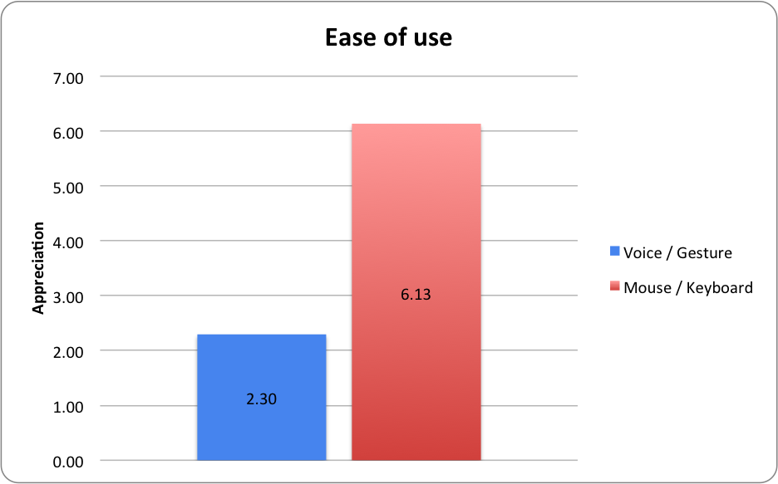
Evaluation results - qualitative

Slide 14
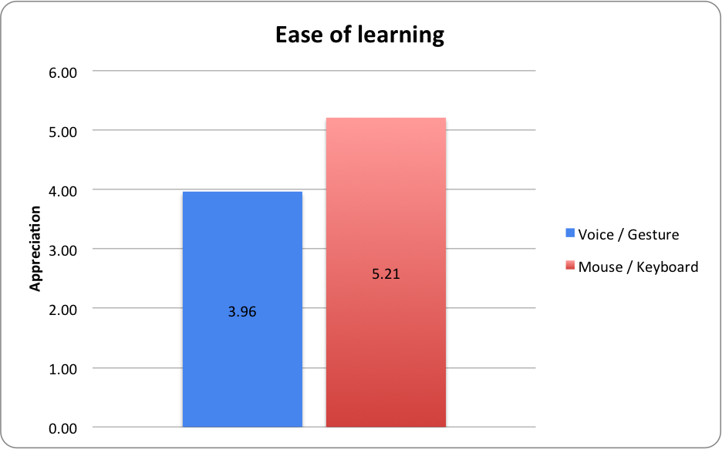
Evaluation results - qualitative

Slide 15
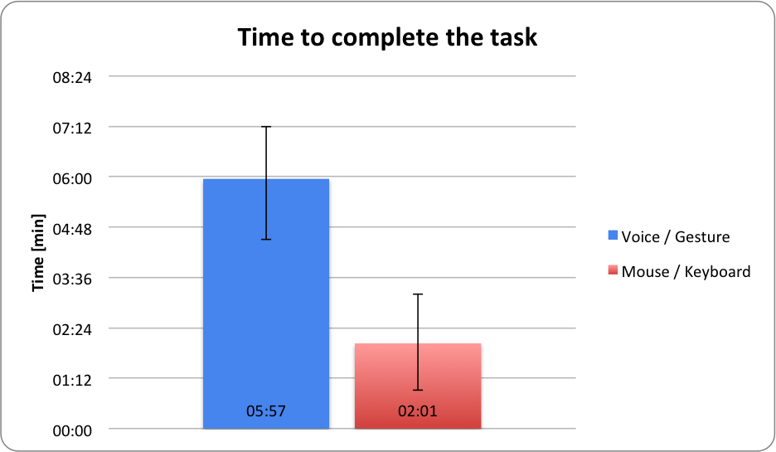
Evaluation results - quantitative

Slide 16
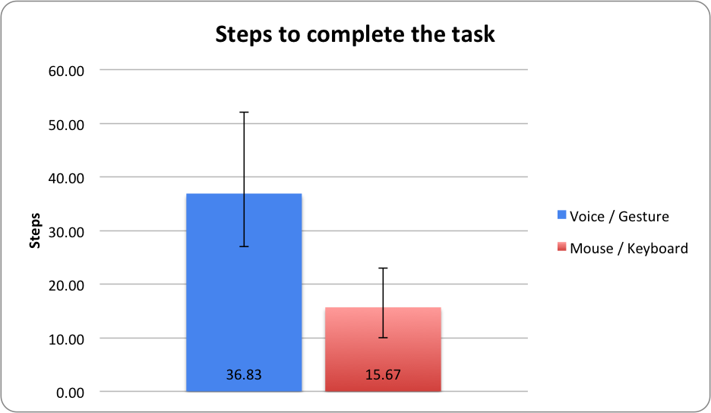
Evaluation results - quantitative

Slide 17
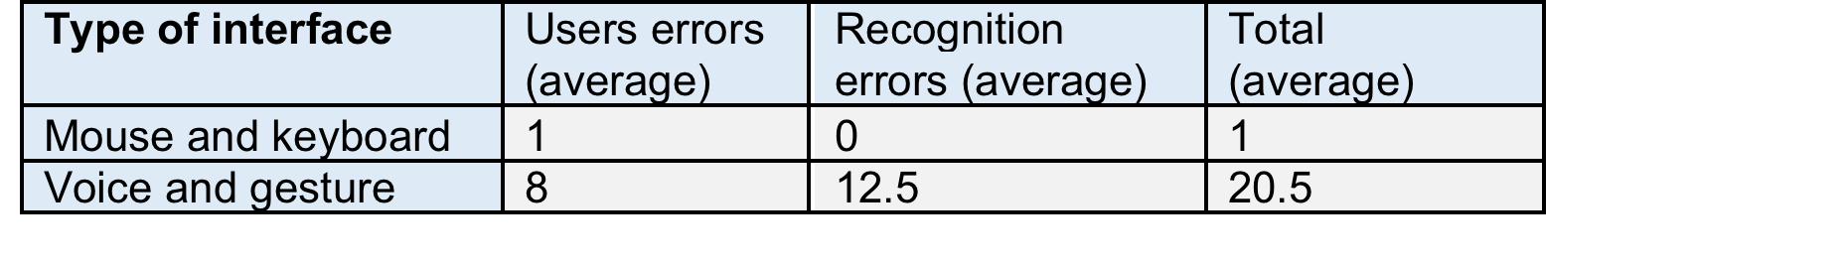
Evaluation results - quantitative
Many errors were recognition errors:

Slide 18
7. Conclusion
In our case keyboard and mouse interaction is more efficient than a multimodal interaction
Redundant modalities corrected some errors
Efficiency of voice and gesture could increase if ergonomics were improved
Technical challenges (tracking, speech recognition…)

Slide 19
Thank you for your attention!
?

